Slide 1










ReFeed Project Team
Mohamed Rezk
Alaa Abdeen
Ibrahim Hosny
Habiba Amr
Aisha Essam
Project manager
Project manager
Project manager
Project manager
Project manager

Slide 2
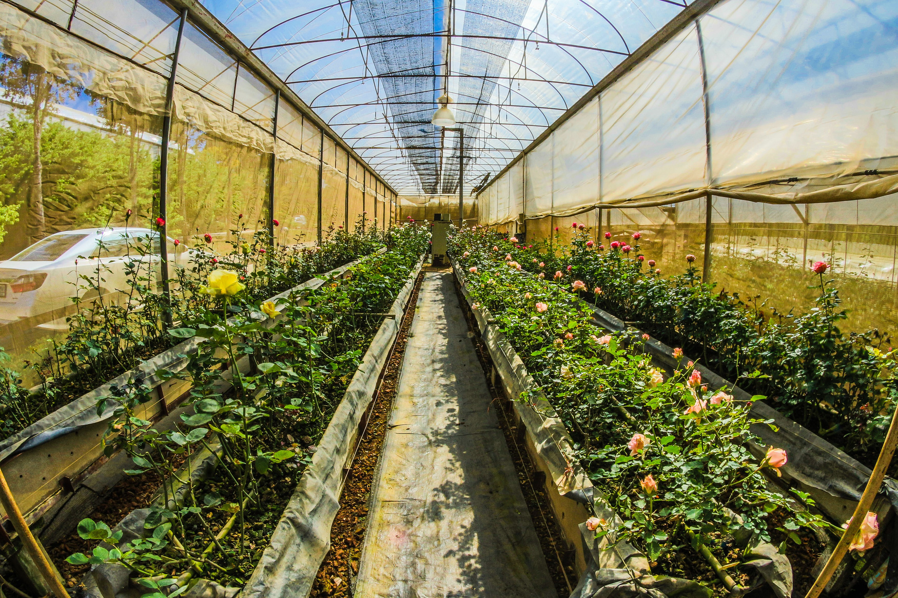
Index
Initiation phase
Planning phase
1.Project Team
10.Milestones
2.Situation Statement
11.WBS
3.Fishbone Diagram
12.Network Diagram & Critical path
4.SWOT analysis
5.SMART goals
13.Gantt Chart
6.OKRs
14.Budget management
7.Stakeholders analaysis & Power Interested grade
15.SOW
8.RACI
17.Risk management
9.Project charter
16.Communication Plan
18.Project Plan
LET'S START

Slide 3



Situation Statement
Problem
As a Refeed company mainly relay on importing goods, we are currently facing serious challenges due to the import crisis .
01. Effect
Customers frustration .
Due to the lack of feed alot of Liestocks will die .
Relying on other unhealthy feed sources .
Increasing of inflation rate of feed prices .
02. Impact
Lack of our inventory .
Shortage of the company foreign currency .
Financial and Reputation losses
High demand .
Delys of supply chain .
Losing partners ( farms & companies ) due to the delays of the supply chain because of the feed shortage .

Slide 4

FISHBONE DIAGRAM
ENVIRONMENT
PEOPLE
THEY DON'T HAVE THE TECHNOLOGY TO GROW SUCH CORPS
DECIDING TO INVEST IN SOME OTHER PRODUCTS
WATER SHORTAGE
THEY GAIN MORE MONEY FROM OTHER CORPS
LEADING TO BAD IMPACT ON LAND & RECOURCES
INVESTORS
CLIMATE CHANGE
FARMERS
SOME TOUGH POLICIES FOR IMPORTING
POOR LANDS
HIGH DEMAND
SOME TOUGH POLICIES
CONSUMERS
POLICYMAKERS
HIGH WASTE OF FOOD OR FEED DUE TO LAKE OF KNOWLEDGE
FEED SHORTAGE IN REFFED
USING INGREDIENTS WITH POOR QUALITY
COST
POOR QUALITY
CREDITS & LOANS
DEPENDING ON OLD TOOLS NOT THE NEW TECHNOLOGY
ROW MATERIALS
USING OLD TOOLS
LAKE OF ACCESS TO AFFORDABLE CREDITS OR LOANS
LIMITED INVESTMENT
SHORTAGE OF ROW MATERIALS FOR FEED
( CORN , SOY , ETC )
HIGH PRICE OF RAW MATERIALS
LAKE OF ALTERNATIVES RESOURCES
FINANCIAL FACTORS
LACK OF FEED ALTERNATIVE SUCH AS USING FOOD WASTE
MATERIALS

Slide 5



ReFeed SWOT analysis
A huge area of ​​fertile land
Specialists with great experience in agriculture .
Hundreds of investors .
Huge number experts Staff .
Enormous inventory .
The presence of huge fertile lands without agriculture
Poor feed systems & technology
Depending on importaning only with sole sourcing and neglecting local manufacturing
Supply chain delays
01.
02.
03.
Achieving self-sufficiency in corn and soybeans for making feed, with possibility of exporting .
Exploiting unused lands for agriculture & increase new jobs
Saving billions of dollars by launching R&D facility .
04.
Climate change
Water shortage
Competitors
Lake of Dollars for importing
Natural disasters
Change of governmental policies

